Slide 1
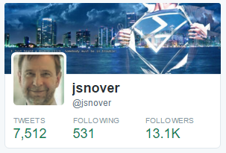
The Cultural Battle To Remove Windows from Windows Server
Jeffrey Snover

Slide 2
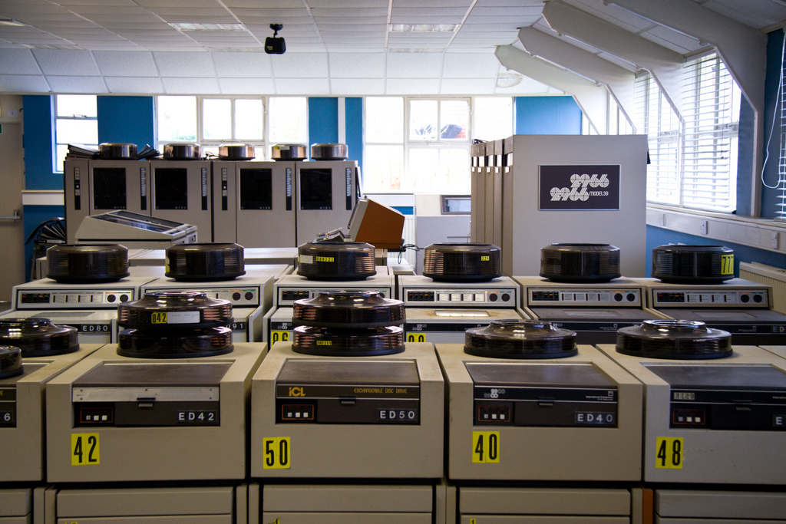
Notes:
This is what Datacenters looked like in the 1980s and 1990s.
It was a world dominated by Traditional vendors like IBM, DEC, and HP

Slide 3
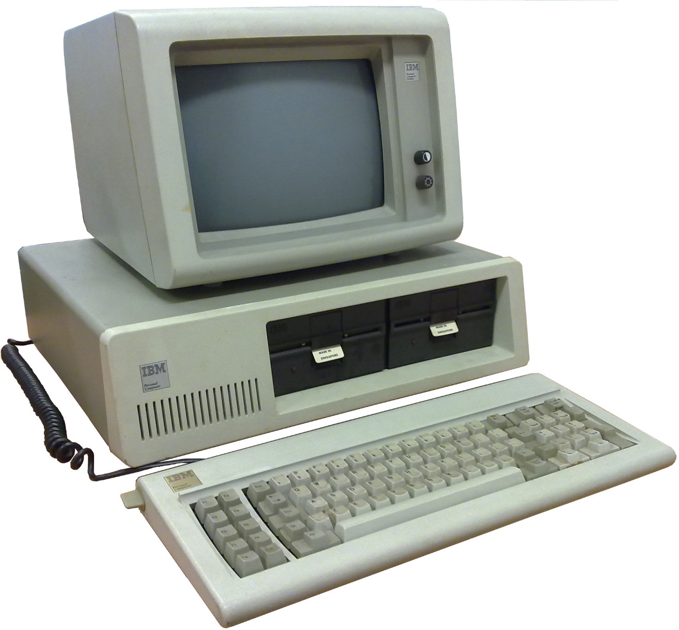
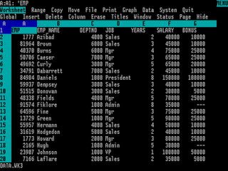
Notes:
Windows was a successful desktop operating system based upon DOS and the CLI

Slide 4
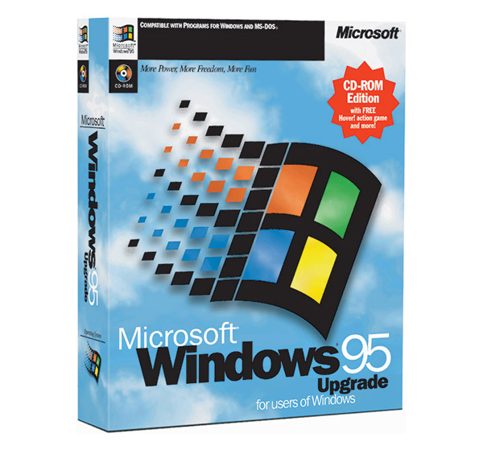
Notes:
The GUI in Windows 95 was an overwhelming success and changed with world.

Slide 5
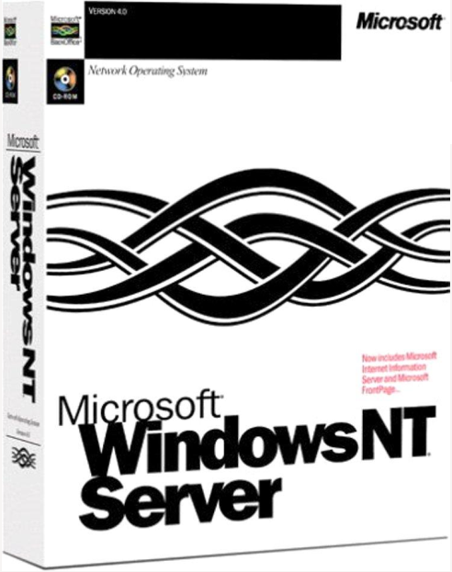
Notes:
The GUI in Windows 95 was an overwhelming success and changed with world. Microsoft also decided to get into the Server business

Slide 6
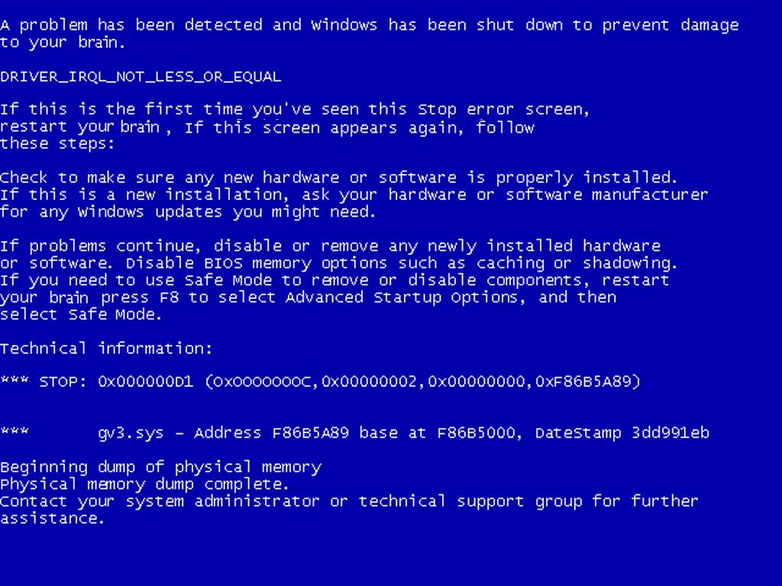
Notes:
At the time, the defining experience of Windows was something call the Blue Screen of death so the idea that you would actually run your business on it was something regarded with a serious amount of skeptism.

Slide 7
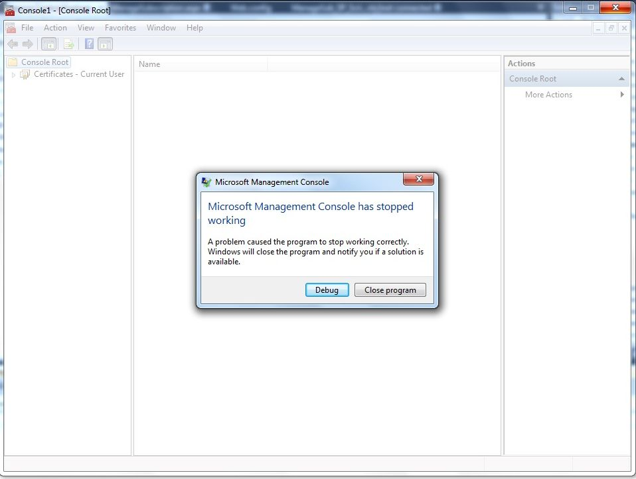
Notes:
Microsoft’s approach to management was running into problems as well.

Slide 8

Notes:
The great thing about Microsoft is our willingness to be self critical and to address our problems.
During a review of the Server business, Bill decided that he needed an industry expert to help them out.

Slide 9


Notes:
That’s when I got the call

Slide 10

WHY?
Notes:
At the time I thought I had the best job in the world working as one of the most senior architects at Tivoli.
I spent most of my career doing network and systems mgmt. and had won a number of awards for my NetView on NT product.
When I got the call from MSFT, I told them that I wasn’t interested – at all.
They kept calling me back and eventually I took the call.

Slide 11
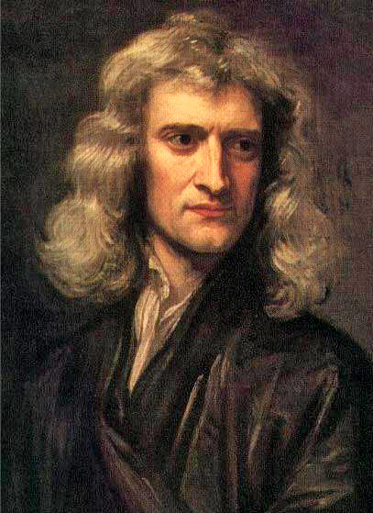
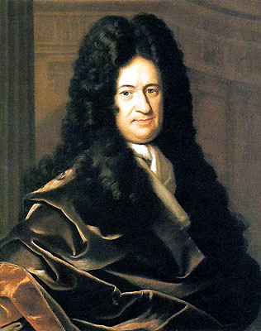
Physics
Newton F = MA
Leibniz Monads
Philosophy
Notes:
To understand why I answered the phone when Microsoft called requires us to understand why I got into software.
I grew up in the 60s and 70s with Vietnam, Nixon, race riots, and the cold war.
The world was an uncertain and scary place and I developed a profound attachment to the orderly and certain world of Newtonian physics.
I learned that one school of philosophy started with the world of dead atoms … consciousness
Leibniz belived that the fundamental unit was consciousness
My studies in philosophy destroyed my world of a order and certainty and it through me into an existential crises.

Slide 12
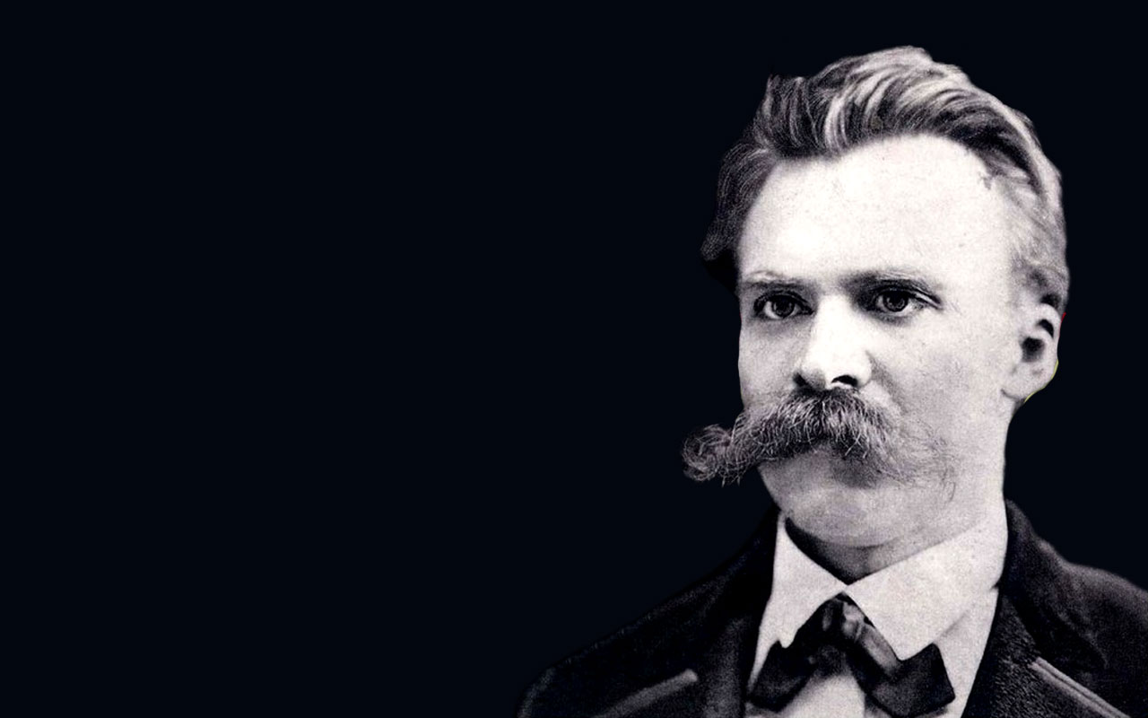
Notes:
My studies brought me to the existentialist Neitzsche who embraced the uncertainly and thought that all ends at death, there is no truth or meaning and that each of us as individuals need to decide what we are going to make our passage through life meaningful.
I decided that for me, having an impact on the world would be the meaning of my life.

Slide 13
Notes:
How many of you have had your lives impacted by Tivoli?
That is why I took the call.

Slide 14


Slide 15
HIRED
Notes:
During my interviews I met some of the most amazingly talented and passionate geeks and I fell in love with the company.
That’s where things started to go pear-shaped.

Slide 16
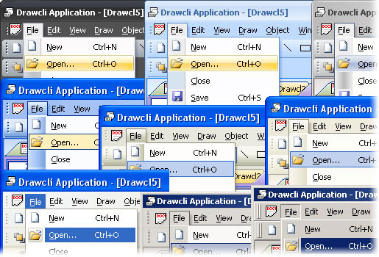
Notes:
You see at the time, the Windows GUI had replace the CLI and was ruling the world.
Microsoft was great at GUIs so the thinking for everything was: if we can make this about the GUI – we Win
Shortly after I arrived, Bill Gates gave a famous demo where he closed what he called “the last command line Window”
The problem was that I knew that Server management was all about automation and that it required CLI and an interactive shell

Slide 17


Slide 18
Automation through CLIs
Which 10?
Notes:
I met a lot of resistance pushing for automation through CLIs but in one meeting I had thought I had achieved a breaktrough when my exec finally agreed to this approach.
But then she asked the Q: Which 10?
I knew I was going to be a long hall.

Slide 19


Slide 20
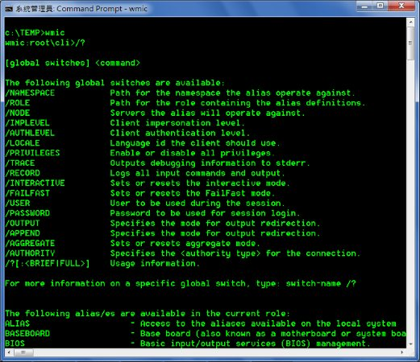
Notes:
We used contractors and spent a ton of money to get 70 commands.
I decided that WMI needed a CLI as well so I got a little bit more money and designed WMIC.
That was a meta-data driven tool with single common parser working against a management interface.
I spent my christmas holiday writing metadata and got 72 commands out of it.
It was such a powerful design that I went back for more money to enhance the filtering and formatting and it worked for all 72 of the commands I had generated.
Clearly I was onto something.

Slide 22

Notes:
The problem with WMIC was WMI which had fallen out of favor as Bill Gates was busy beating everyone to move to .NET
I decided I would explore what this .NET was by rewriting WMIC in it.

Slide 23
The Deep Rethink
A | B |C
Notes:
That was the genesis of Monad because as I did the rewrite, I stepped back and did a deep rethink of the model and had a profound insight.

Slide 24
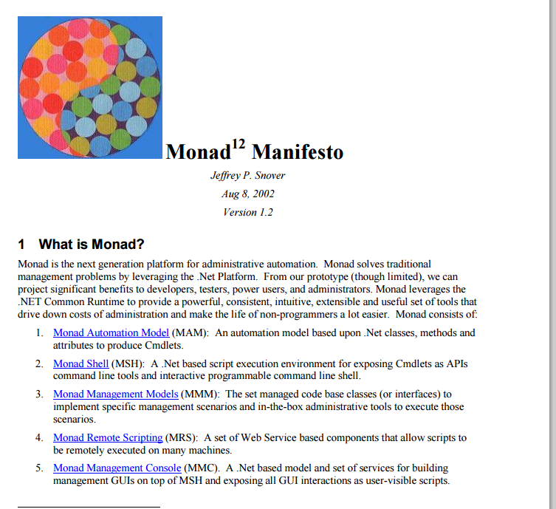
The Problem
Philosophy & approach
A roadmap
What success looks like
Framework for contribution
Notes:
I eventually wrote the Monad Manifesto which articulated:
The Problem
My philosophy and approach to solving the problem
A roadmap for what we would deliver
A crisp articulation for how this would change the world for different audiences
This was by far, the best work I had ever done and I decided to dedicate myself full time to work on it.

Slide 25
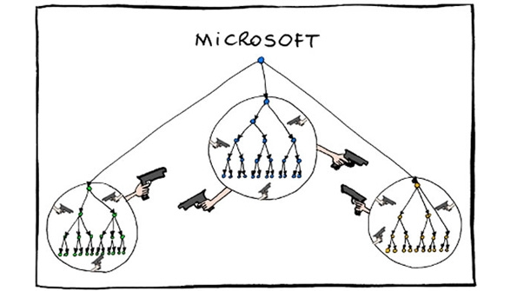
Demoted!
Notes:
I was demoted.
From their perspective – it made total sense – they had hired this industry expert to turn around their management strategy and this idiot wanted to take us back to the 1970s working on a CLI

Slide 26


Slide 27


Slide 28
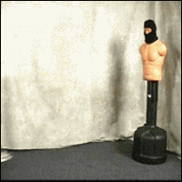

Slide 29
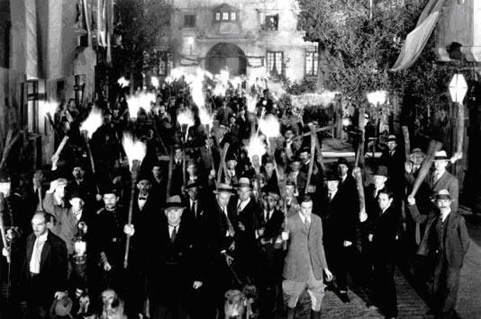

Slide 30
7 rules for using .NET in Windows

Slide 31
“Admins don’t want CLIs” “Which part of F@!$ng Windows is confusing you?”

Slide 34
CLI AND GUI
not
CLI VERSUS GUI
GUIs on clients remotely managing servers

Slide 35

Coalition of the Willing

Slide 36
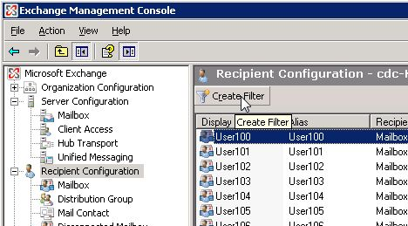

Slide 37
7 Rules for using .NET in Windows
8
x
NO .NET in Windows

Slide 40


Slide 41


Slide 42
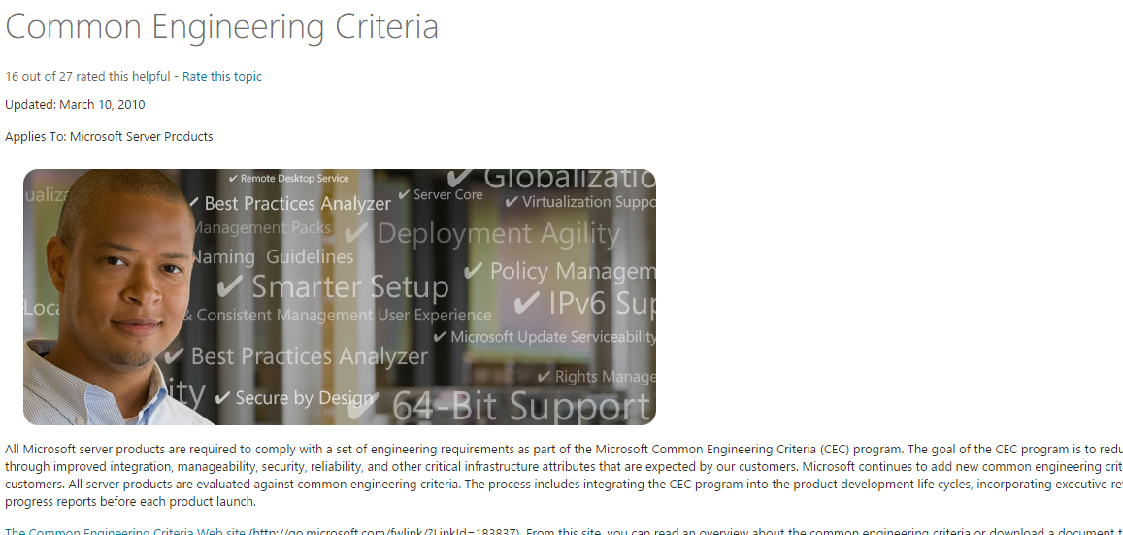

Slide 43


Slide 45

Distinguished Engineer & Lead Architect

Slide 46

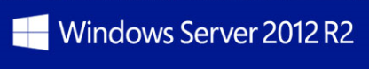
Distinguished Engineer & Lead Architect

Slide 47
Nano Server - Next Step in Our Server Journey
A new headless, 64-bit only, deployment option for Windows Server

Slide 48
Nano Server
6.3
300
5.42
40
.4
.41

Slide 49
Technical Fellow & Lead Architect
Enterprise Cloud Group
Windows Server
System Center
Operations Management Suite
Microsoft Azure Stack

Slide 50
Technical Fellow
> 100K employees
23 Technical Fellows (TF)
11 Individual Contributors (IC)
3 of our 5 Turing Award winners are TFs

Slide 52
The Cultural Battle To Remove Windows from Windows Server

Slide 53
Changing Culture

Slide 54
Changing Culture
Align with business objectives

Slide 55
Changing Culture
Align with business objectives
Why & How > what & when

Slide 56
Changing Culture
Align with business objectives
Why & How > what & when
Start small

Slide 57
Changing Culture
Align with business objectives
Why & How > what & when
Start small
Leverage success to expand

Slide 58
Changing Culture
Align with business objectives
Why & How > what & when
Start small
Leverage success to expand
Respect the existing culture
CLI AND GUI
not
CLI VERSUS GUI

Slide 59
You need chaos in your soul
to give birth
to a dancing star

Slide 61

Complete the online survey for a chance to win a Jolt USB charger.
http://aka.ms/does15

